Slide 1
Lecture 22. Visualizing and Understanding

Slide 2
Last time
One time set up: activation functions, preprocessing, weight initialization, regularization, gradient checking
Training dynamics: babysitting the learning process, parameter updates, hyperparameter optimization
Evaluation: model ensembles, test-time augmentation, transfer learning

Slide 3
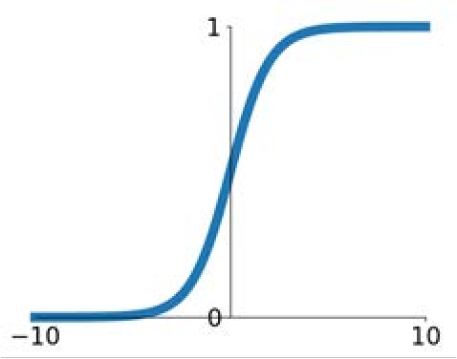
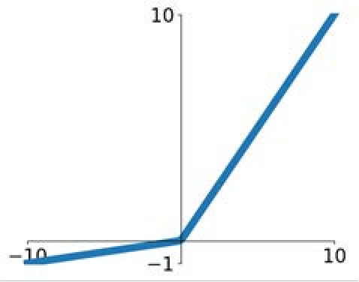
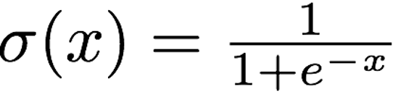
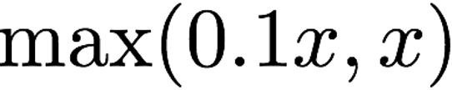
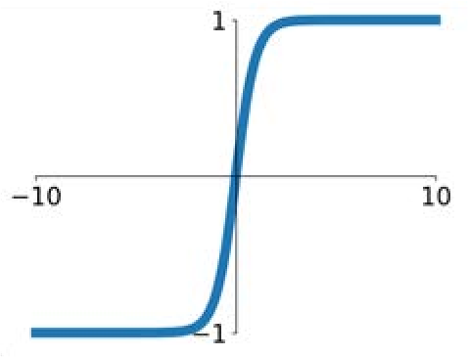
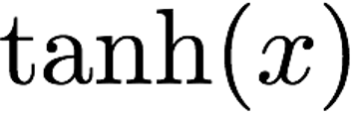
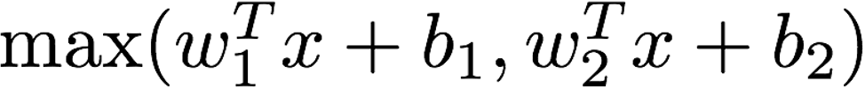
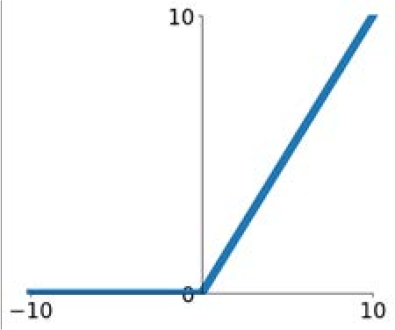
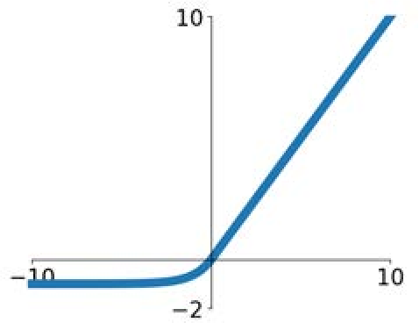
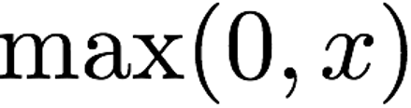
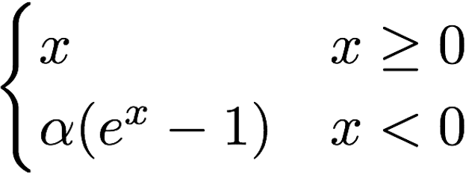
Last time: Activation Functions
Sigmoid
tanh
Leaky ReLU
Maxout
ReLU
ELU
Sitzmann, Vincent, et al. "Implicit neural representations with periodic activation functions." Advances in Neural Information Processing Systems 33 (2020): 7462-7473.

Slide 4
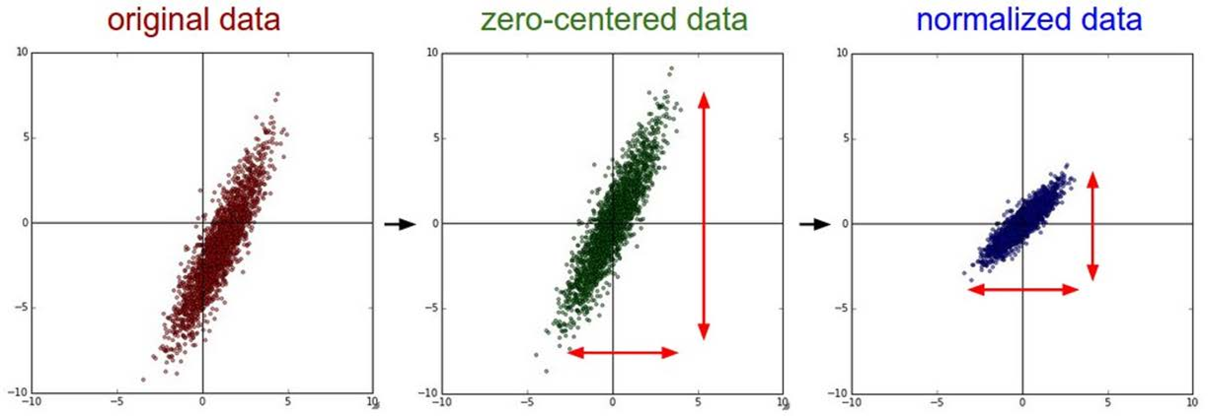
Last time: Data Preprocessing
(Assume X [NxD] is data matrix, each example in a row)

Slide 5
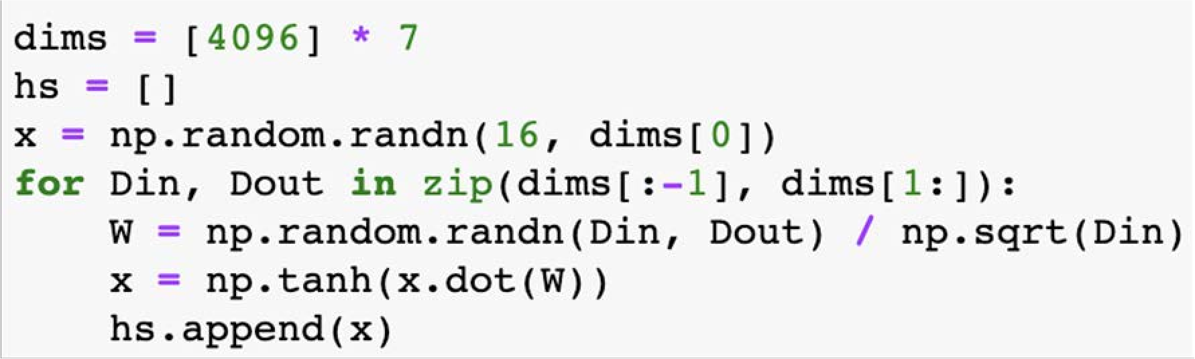
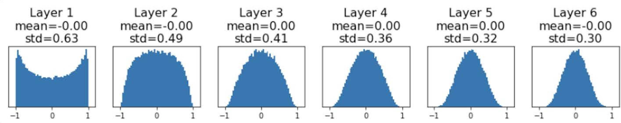
Last time: Weight Initialization
“Just right”: Activations are nicely scaled for all layers!
“Xavier” initialization: std = 1/sqrt(Din)
Glorot and Bengio, “Understanding the difficulty of training deep feedforward neural networks”, AISTAT 2010

Slide 6
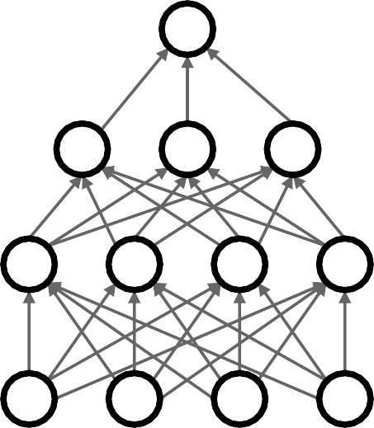

Last time: Dropout Regularization
In each forward pass, randomly set some neurons to zero Probability of dropping is a hyperparameter; 0.5 is common
Srivastava et al, “Dropout: A simple way to prevent neural networks from overfitting”, JMLR 2014

Slide 7
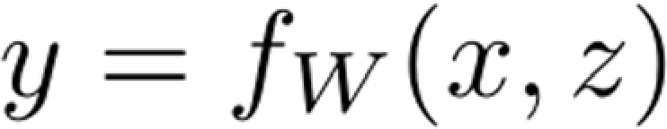
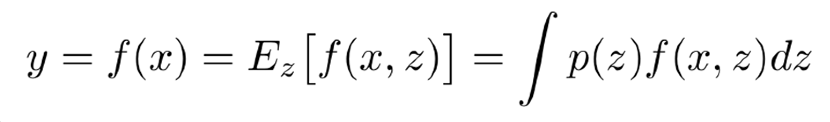
Last time: A common pattern of regularization
Example: Batch Normalization
Training: Normalize using stats from random minibatches
Training: Add some kind of randomness
Testing: Average out randomness (sometimes approximate)
Testing: Use fixed stats to normalize

Slide 8
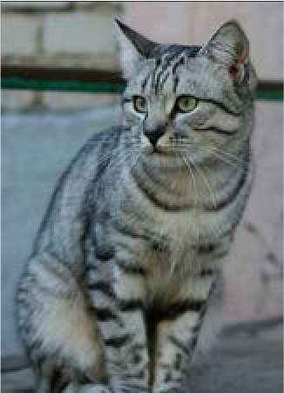
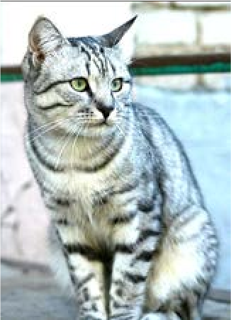
Last time: Data Augmentation
Load image and label
“cat”
Compute loss
CNN
Horizontal flipping, random crops and scales, color jitter, …

Slide 9
Choosing Hyperparameters
Step 1: Check initial loss
Step 2: Overfit a small sample
Step 3: Find LR that makes loss go down
Step 4: Coarse grid, train for ~1-5 epochs
Step 5: Refine grid, train longer
Step 6: Look at loss and accuracy curves
Step 7: GOTO step 5

Slide 10
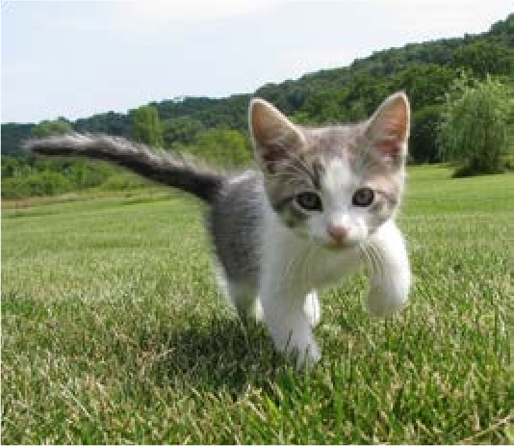
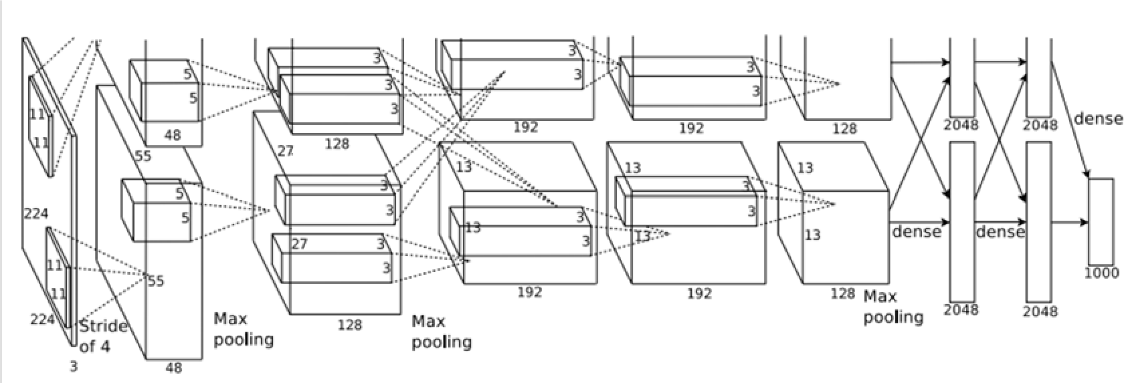
Today: What’s going on inside ConvNets?
This image is CC0 public domain
Class Scores: 1000 numbers
Input Image: 3 x 224 x 224
What are the intermediate features looking for?
Krizhevsky et al, “ImageNet Classification with Deep Convolutional Neural Networks”, NIPS 2012.
Notes:
引出卷积网络里面的特征的学习

Slide 11
Today's agenda
Visualizing what models have learned:
Visualizing filters
Visualizing final layer features
Visualizing activations
Understanding input pixels
Identifying important pixels
Saliency via backprop
Guided backprop to generate images
Gradient ascent to visualize features
Adversarial perturbations
Style transfer
Features inversion
Deep dream
Texture synthesis
Neural style transfer

Slide 12
Today's agenda
Visualizing what models have learned:
Visualizing filters
Visualizing final layer features
Visualizing activations
Understanding input pixels
Identifying important pixels
Saliency via backprop
Guided backprop to generate images
Gradient ascent to visualize features
Adversarial perturbations
Style transfer
Features inversion
Deep dream
Texture synthesis
Neural style transfer

Slide 13
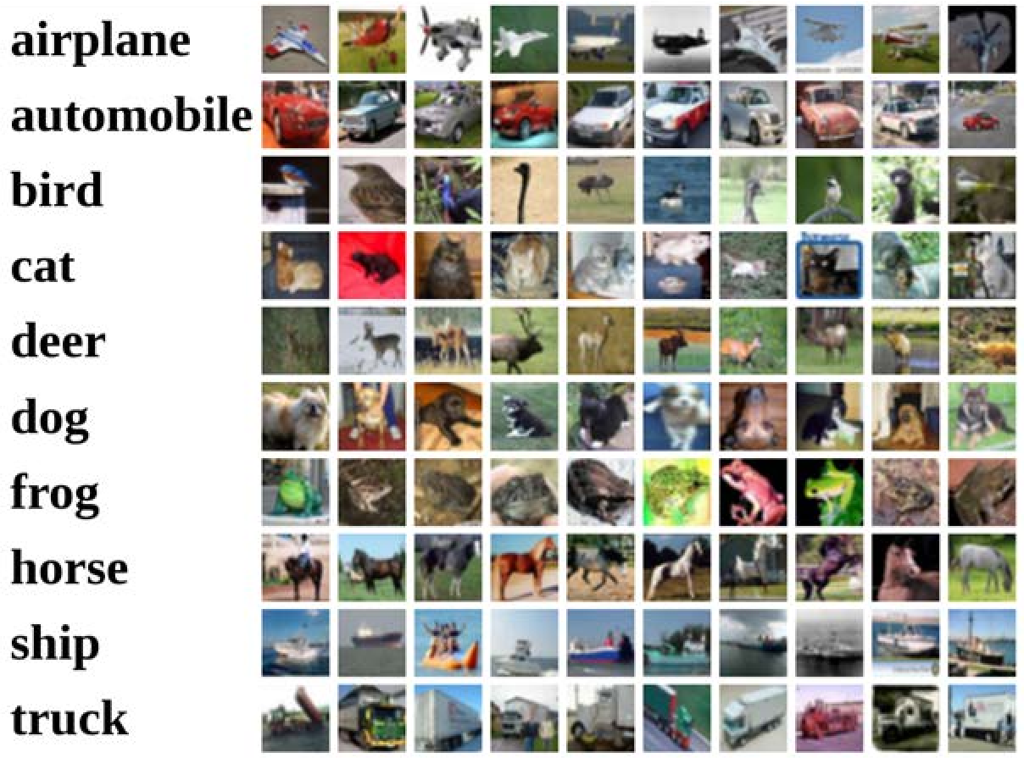
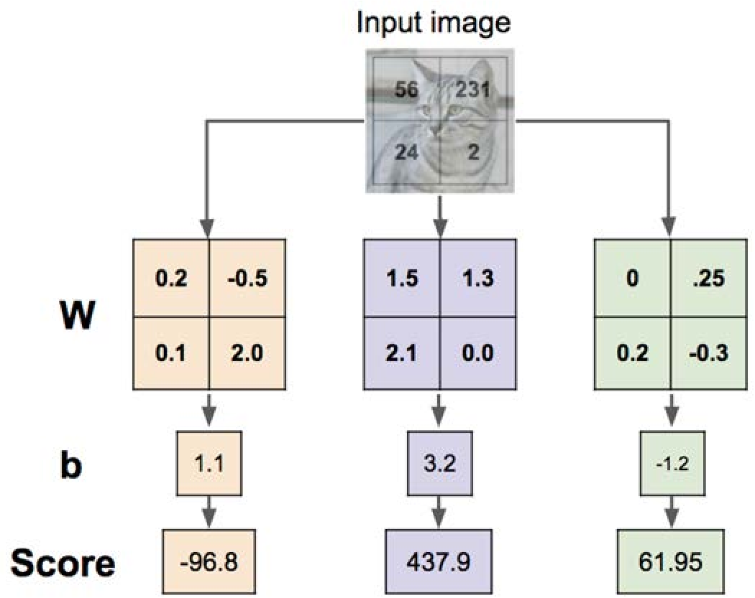
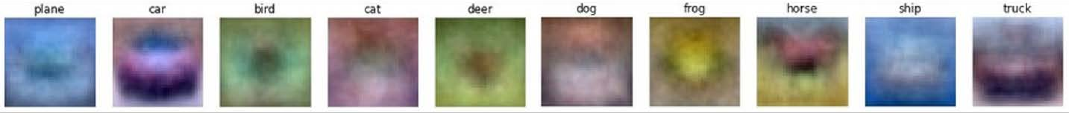
Interpreting a Linear Classifier: Visual Viewpoint
Notes:
不同w和b的网络计算得到的图像特征

Slide 14
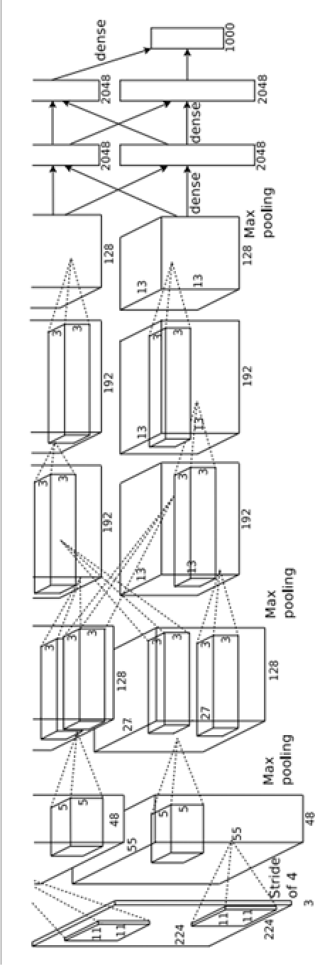
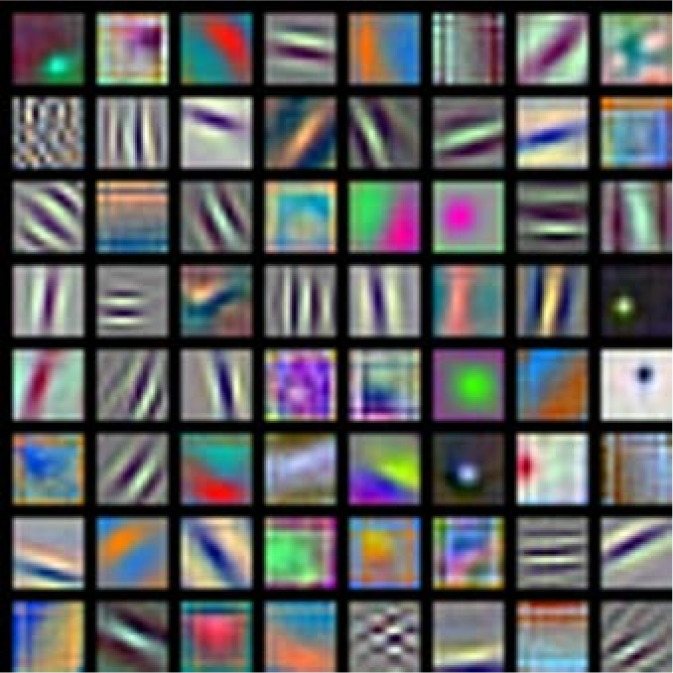
First Layer: Visualize Filters
AlexNet:
64 x 3 x 11 x 11
Krizhevsky, “One weird trick for parallelizing convolutional neural networks”, arXiv 2014 He et al, “Deep Residual Learning for Image Recognition”, CVPR 2016
Huang et al, “Densely Connected Convolutional Networks”, CVPR 2017
Notes:
第一层网络卷积核可视化，结果与传统方法得到的“定向边缘”很类似。无论用什么网络和数据集训练都会有类似的结果。

Slide 15
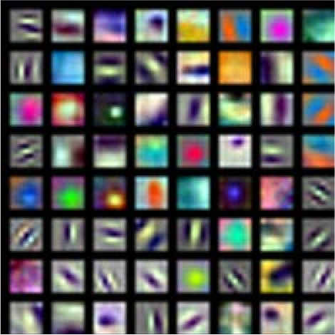
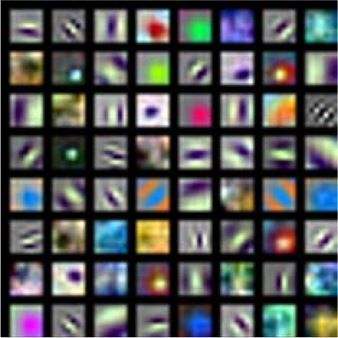
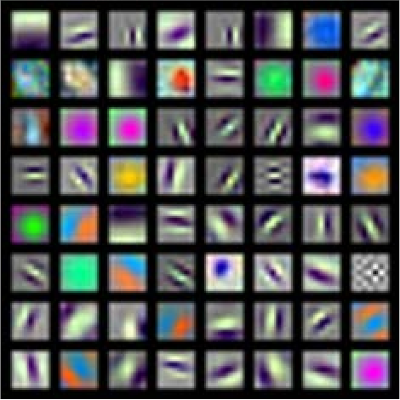
First Layer: Visualize Filters
ResNet-18: 64 x 3 x 7 x 7
ResNet-101: 64 x 3 x 7 x 7
DenseNet-121: 64 x 3 x 7 x 7
AlexNet:
64 x 3 x 11 x 11
Krizhevsky, “One weird trick for parallelizing convolutional neural networks”, arXiv 2014 He et al, “Deep Residual Learning for Image Recognition”, CVPR 2016
Huang et al, “Densely Connected Convolutional Networks”, CVPR 2017

Slide 16
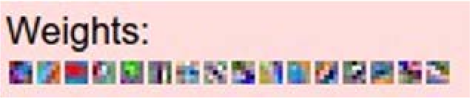
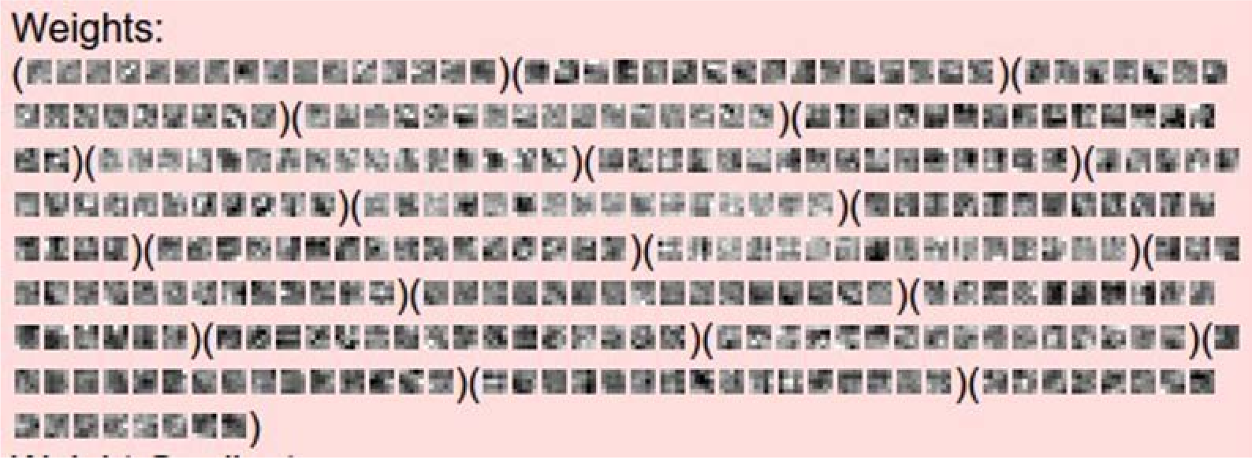
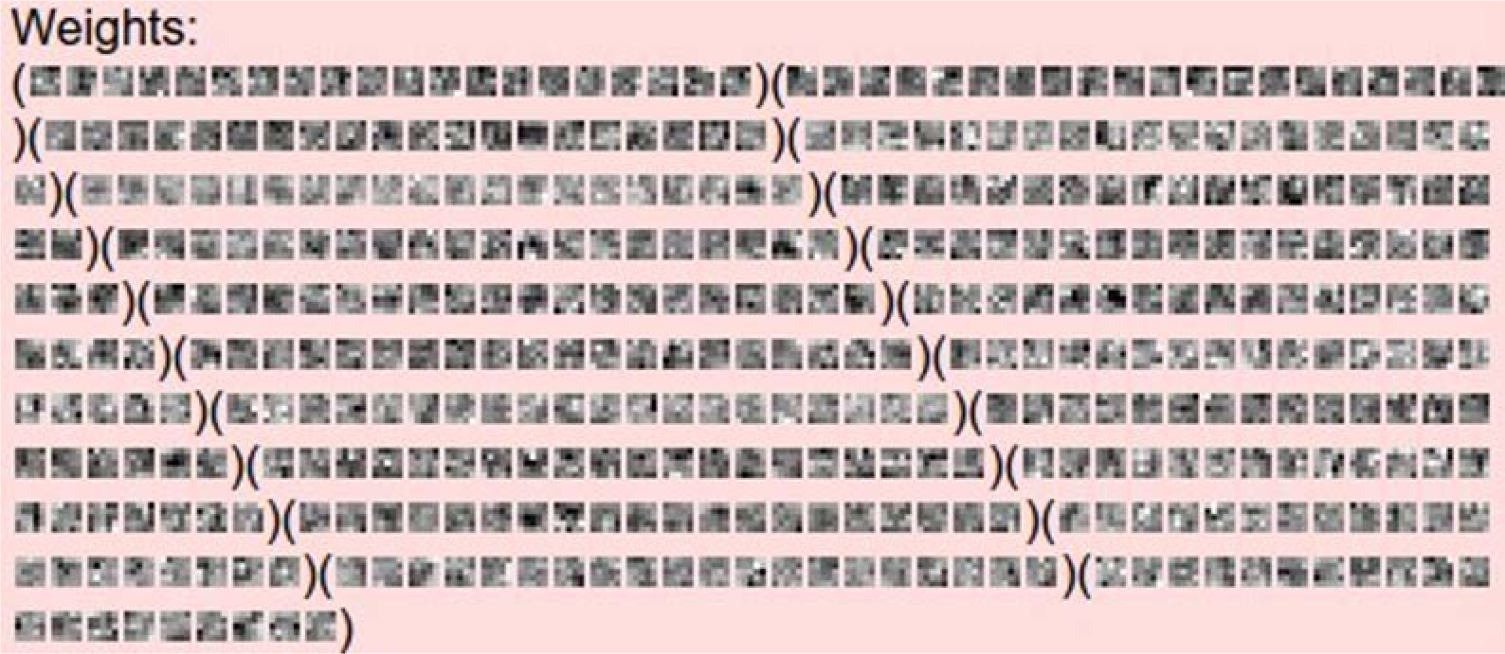
Other Layers: Visualize Filters
Visualize the filters/kernels (raw weights)
layer 1 weights
16 x 3 x 7 x 7
layer 2 weights
20 x 16 x 7 x 7
We can visualize filters at higher layers, but not that interesting
(these are taken from ConvNetJS CIFAR-10
demo)
layer 3 weights
20 x 20 x 7 x 7

Slide 17
Last Layer
FC7 layer
4096-dimensional feature vector for an image (layer immediately before the classifier)
Run the network on many images, collect the feature vectors

Slide 18
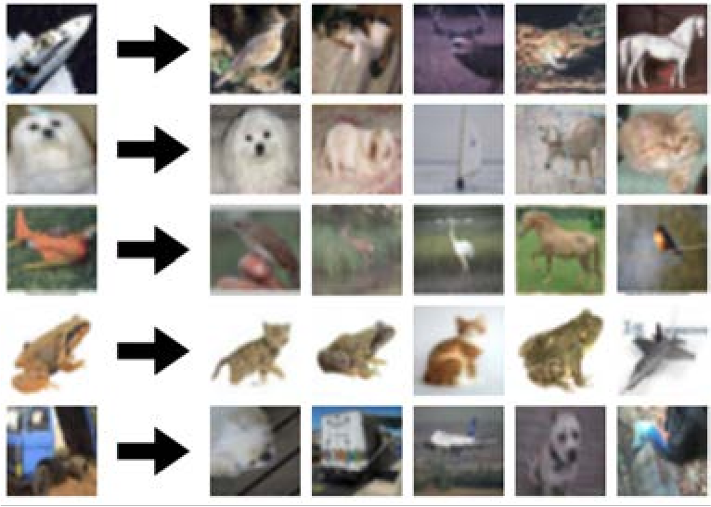
Last Layer: Nearest Neighbors
Recall: Nearest neighbors in pixel space
Krizhevsky et al, “ImageNet Classification with Deep Convolutional Neural Networks”, NIPS 2012. Figures reproduced with permission.
Notes:
可以用linear层4096的特征向量做相似图检索

Slide 19
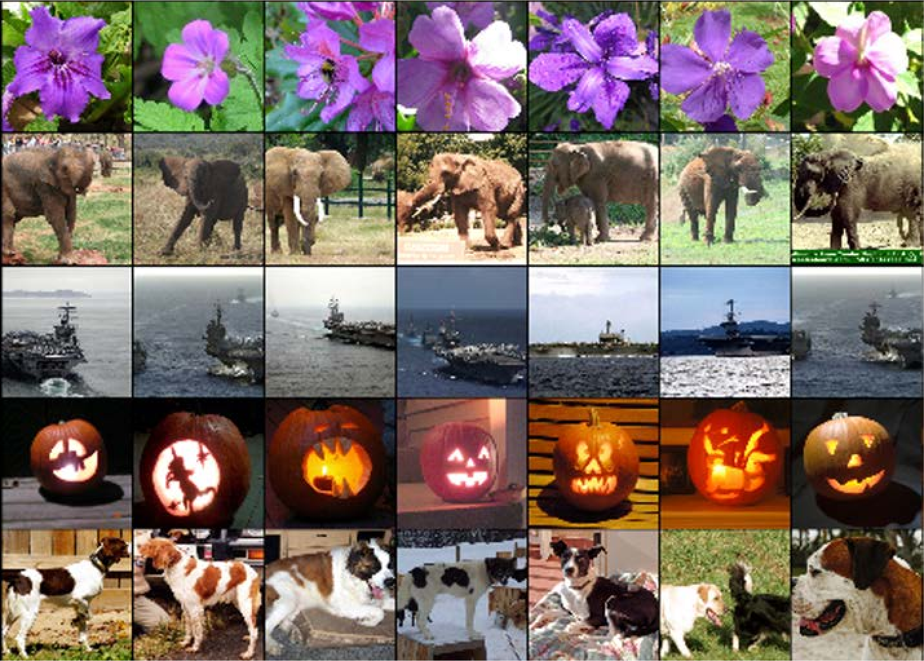
Last Layer: Nearest Neighbors
4096-dim vector
Test image
L2 Nearest neighbors in feature space
Recall: Nearest neighbors in pixel space
Krizhevsky et al, “ImageNet Classification with Deep Convolutional Neural Networks”, NIPS 2012. Figures reproduced with permission.

Slide 20
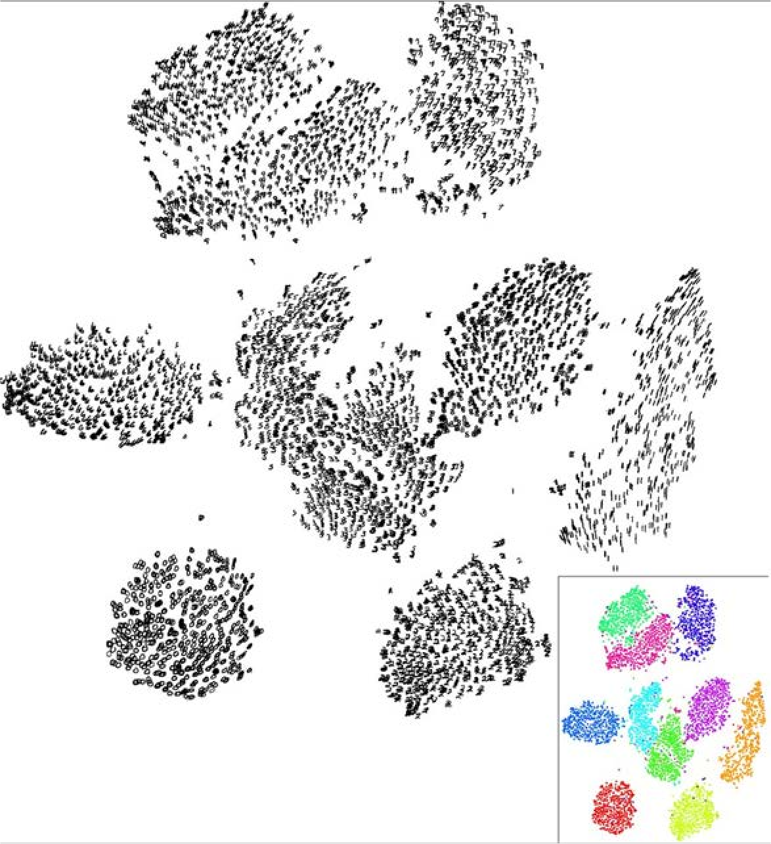
Last Layer: Dimensionality Reduction
Visualize the “space” of FC7 feature vectors by reducing dimensionality of vectors from 4096 to 2 dimensions
Simple algorithm: Principal Component Analysis (PCA)
More complex: t-SNE
Van der Maaten and Hinton, “Visualizing Data using t-SNE”, JMLR 2008
Figure copyright Laurens van der Maaten and Geoff Hinton, 2008. Reproduced with permission.
Notes:
这个可视化结果是t-SNE。t-SNE是一种更比PCA更复杂的降维算法

Slide 21
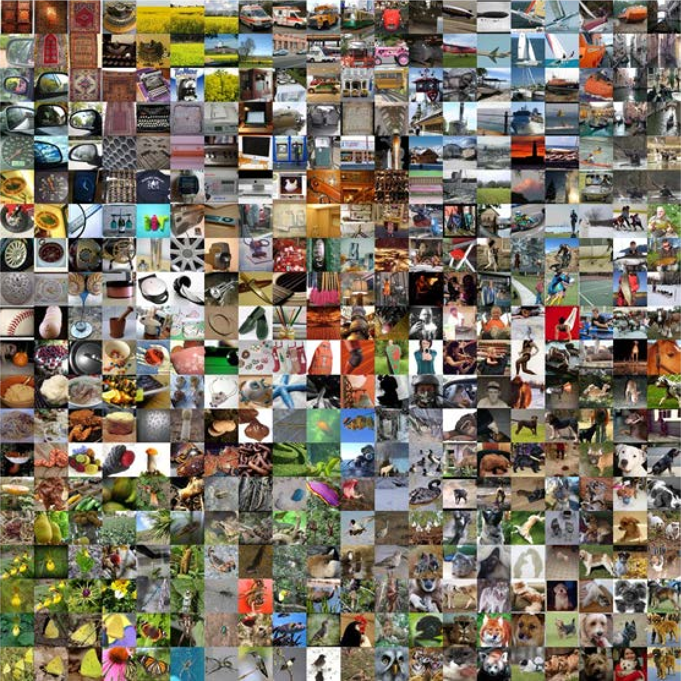
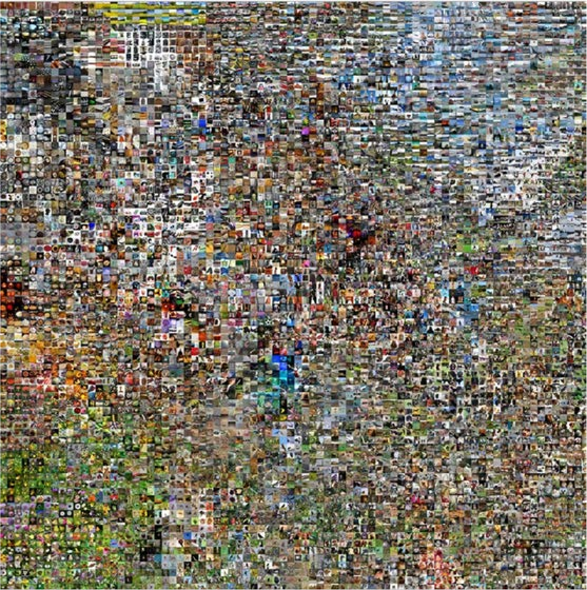
Last Layer: Dimensionality Reduction
Van der Maaten and Hinton, “Visualizing Data using t-SNE”, JMLR 2008
Krizhevsky et al, “ImageNet Classification with Deep Convolutional Neural Networks”, NIPS 2012.
See high-resolution versions at
http://cs.stanford.edu/people/karpathy/cnnembed/
Notes:
把4096特征向量降维转为patch,再把patch对应回原图位置的可视化结果

Slide 22
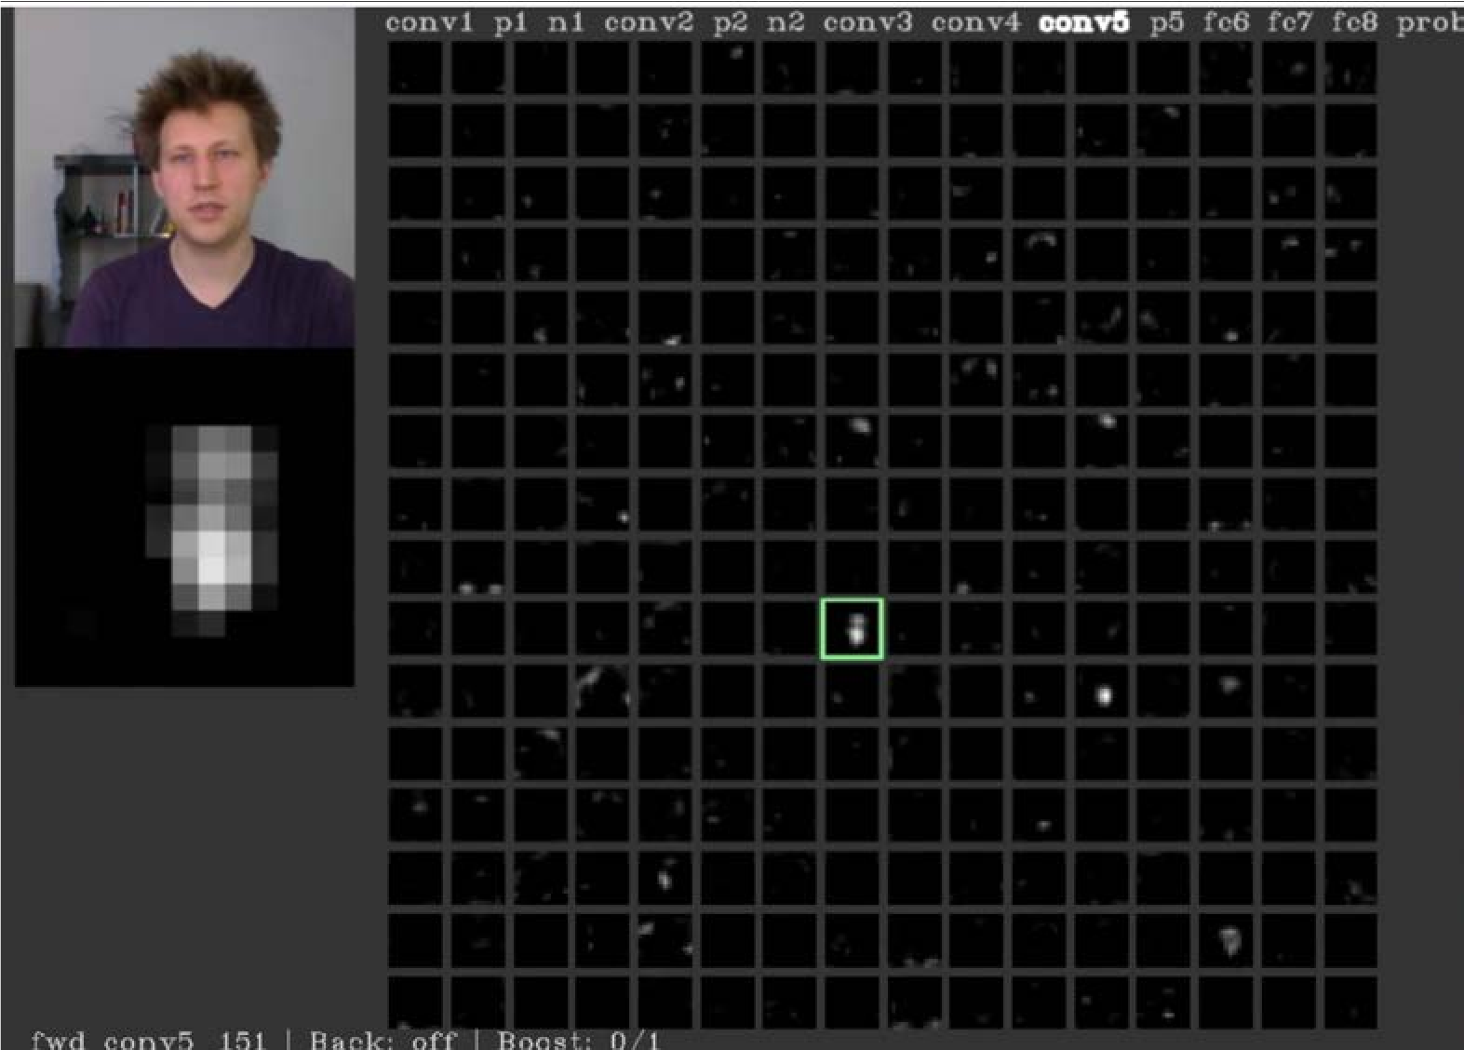
Visualizing Activations
conv5 feature map is 128x13x13; visualize as 128 13x13 grayscale images
Yosinski et al, “Understanding Neural Networks Through Deep Visualization”, ICML DL Workshop 2014. Figure copyright Jason Yosinski, 2014. Reproduced with permission.
Notes:
一个有趣的软件，可视化网络多层的卷积核

Slide 23
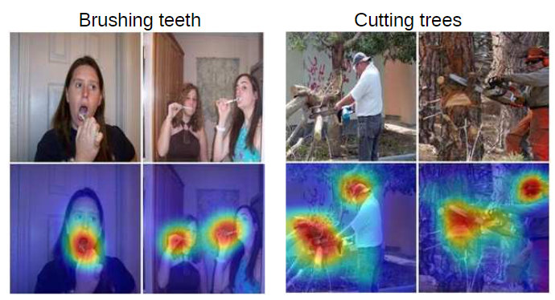
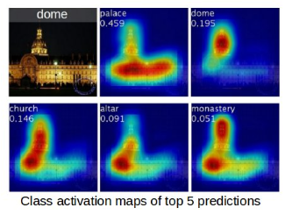
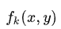
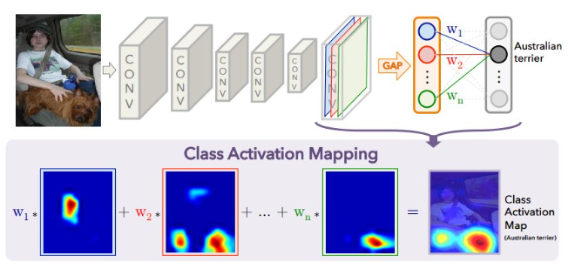
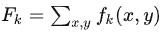
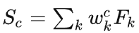
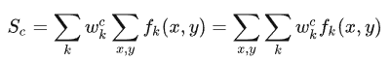
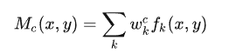
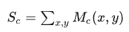
Class Activation Mapping (CAM)
Activations of k-th channel in the last convolutional layer:
GAP： global average pooling
GAP for k-th channel
Score for class c:
CAM for class c:
Extension: Grad-CAM
B. Zhou et al, “Learning Deep Features for Discriminative Localization”, CVPR 2016
Notes:
一个有趣的软件，可视化网络多层的卷积核

Slide 24
Today's agenda
Visualizing what models have learned:
Visualizing filters
Visualizing final layer features
Visualizing activations
Understanding input pixels
Identifying important pixels
Saliency via backprop
Guided backprop to generate images
Gradient ascent to visualize features
Adversarial perturbations
Style transfer
Features inversion
Deep dream
Texture synthesis
Neural style transfer

Slide 25
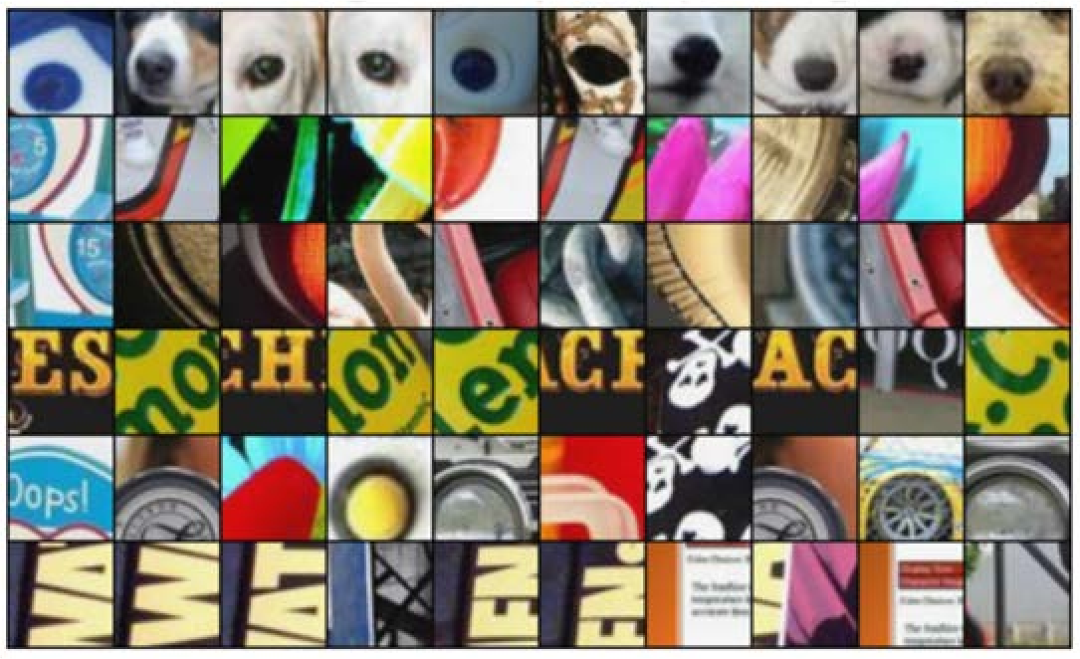
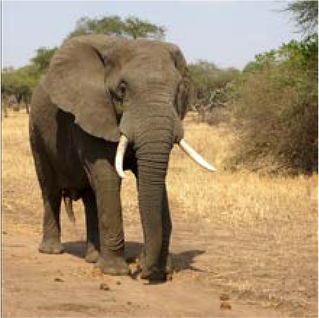
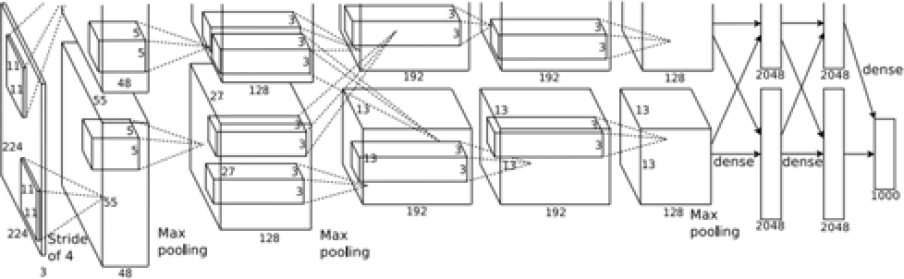

Maximally Activating Patches
Pick a layer and a channel; e.g. conv5 is 128 x 13 x 13, pick channel 17/128
Run many images through the network, record values of chosen channel
Visualize image patches that correspond to maximal activations
Springenberg et al, “Striving for Simplicity: The All Convolutional Net”, ICLR Workshop 2015
Figure copyright Jost Tobias Springenberg, Alexey Dosovitskiy, Thomas Brox, Martin Riedmiller, 2015; reproduced with permission.
Notes:
找出网络激活值最大的卷积核并进行可视化，从而知道网络在学习什么样的特征（多种图片都显示有圆圆的特征）

Slide 26




Which pixels matter: Saliency via Occlusion
Mask part of the image before feeding to CNN, check how much predicted probabilities change
P(elephant) = 0.95
P(elephant) = 0.75
Zeiler and Fergus, “Visualizing and Understanding Convolutional Networks”, ECCV 2014

Slide 27



Which pixels matter: Saliency via Occlusion
Mask part of the image before feeding to CNN, check how much predicted probabilities change
Zeiler and Fergus, “Visualizing and Understanding Convolutional Networks”, ECCV 2014

Slide 28


Which pixels matter: Saliency via Backprop
Forward pass: Compute probabilities
Dog
Simonyan, Vedaldi, and Zisserman, “Deep Inside Convolutional Networks: Visualising Image Classification Models and Saliency Maps”, ICLR Workshop 2014.
Figures copyright Karen Simonyan, Andrea Vedaldi, and Andrew Zisserman, 2014; reproduced with permission.
Notes:
显著性检测，找出与从目标类别到图像像素种，梯度最大的像素

Slide 29

Which pixels matter: Saliency via Backprop
Forward pass: Compute probabilities
Dog
Compute gradient of (unnormalized) class score with respect to image pixels, take absolute value and max over RGB channels
Simonyan, Vedaldi, and Zisserman, “Deep Inside Convolutional Networks: Visualising Image Classification Models and Saliency Maps”, ICLR Workshop 2014.
Figures copyright Karen Simonyan, Andrea Vedaldi, and Andrew Zisserman, 2014; reproduced with permission.

Slide 30


Saliency Maps
Simonyan, Vedaldi, and Zisserman, “Deep Inside Convolutional Networks: Visualising Image Classification Models and Saliency Maps”, ICLR Workshop 2014.
Figures copyright Karen Simonyan, Andrea Vedaldi, and Andrew Zisserman, 2014; reproduced with permission.

Slide 31

Saliency Maps: Segmentation without supervision
Use GrabCut on saliency map
Simonyan, Vedaldi, and Zisserman, “Deep Inside Convolutional Networks: Visualising Image Classification Models and Saliency Maps”, ICLR Workshop 2014.
Figures copyright Karen Simonyan, Andrea Vedaldi, and Andrew Zisserman, 2014; reproduced with permission.
Rother et al, “Grabcut: Interactive foreground extraction using iterated graph cuts”, ACM TOG 2004

Slide 32

Saliency maps: Uncovers biases
Such methods also find biases
wolf vs dog classifier looks is actually a snow vs no- snow classifier
Figures copyright Marco Tulio Ribeiro, Sameer Singh, and Carlos Guestrin, 2016; reproduced with permission. Ribeiro et al, ““Why Should I Trust You?” Explaining the Predictions of Any Classifier”, ACM KDD 2016

Slide 33



Intermediate Features via (guided) backprop
ReLU
Pick a single intermediate neuron, e.g. one value in 128 x 13 x 13 conv5 feature map
Compute gradient of neuron value with respect to image pixels
Images come out nicer if you only backprop positive gradients through each ReLU (guided backprop)
Zeiler and Fergus, “Visualizing and Understanding Convolutional Networks”, ECCV 2014
Figure copyright Jost Tobias Springenberg, Alexey Dosovitskiy, Thomas
Brox, Martin Riedmiller, 2015; reproduced with permission.
Springenberg et al, “Striving for Simplicity: The All Convolutional Net”, ICLR Workshop 2015
Notes:
神经元对于图像像素的梯度反应了像素的重要程序，反向传播时只传播正值会取得很有趣的结果

Slide 34


Intermediate features via (guided) backprop
Maximally activating patches (Each row is a different neuron)
Guided Backprop
Zeiler and Fergus, “Visualizing and Understanding Convolutional Networks”, ECCV 2014 Springenberg et al, “Striving for Simplicity: The All Convolutional Net”, ICLR Workshop 2015
Figure copyright Jost Tobias Springenberg, Alexey Dosovitskiy, Thomas Brox, Martin Riedmiller, 2015; reproduced with permission.
Notes:
这种guided bakcprop会使得卷积核的可视化更加清晰，从而知道网络在学习什么

Slide 35


Intermediate features via (guided) backprop
Maximally activating patches (Each row is a different neuron)
Guided Backprop
Zeiler and Fergus, “Visualizing and Understanding Convolutional Networks”, ECCV 2014 Springenberg et al, “Striving for Simplicity: The All Convolutional Net”, ICLR Workshop 2015
Figure copyright Jost Tobias Springenberg, Alexey Dosovitskiy, Thomas Brox, Martin Riedmiller, 2015; reproduced with permission.

Slide 36
Visualizing CNN features: Gradient Ascent
(Guided) backprop: Find the part of an image that a neuron responds to
Gradient ascent: Generate a synthetic image that maximally activates a neuron
I* = arg max_{I} +
f(I)
R(I)
Neuron value
Natural image regularizer

Slide 37


Visualizing CNN features: Gradient Ascent
1. Initialize image to zeros
score for class c (before Softmax)
zero image
Repeat:
Forward image to compute current scores
Backprop to get gradient of neuron value with respect to image pixels
Make a small update to the image

Slide 38

Visualizing CNN features: Gradient Ascent
Simple regularizer: Penalize L2 norm of generated image
Simonyan, Vedaldi, and Zisserman, “Deep Inside Convolutional Networks: Visualising Image Classification Models and Saliency Maps”, ICLR Workshop 2014.
Figures copyright Karen Simonyan, Andrea Vedaldi, and Andrew Zisserman, 2014; reproduced with permission.

Slide 39

Visualizing CNN features: Gradient Ascent
Simple regularizer: Penalize L2 norm of generated image
Simonyan, Vedaldi, and Zisserman, “Deep Inside Convolutional Networks: Visualising Image Classification Models and Saliency Maps”, ICLR Workshop 2014.
Figures copyright Karen Simonyan, Andrea Vedaldi, and Andrew Zisserman, 2014; reproduced with permission.
Notes:
Gradient ascent生成的图像和类别十分符合

Slide 40

Visualizing CNN features: Gradient Ascent
Simple regularizer: Penalize L2 norm of generated image
Simonyan, Vedaldi, and Zisserman, “Deep Inside Convolutional Networks: Visualising Image Classification Models and Saliency Maps”, ICLR Workshop 2014.
Figures copyright Karen Simonyan, Andrea Vedaldi, and Andrew Zisserman, 2014; reproduced with permission.

Slide 41
Visualizing CNN features: Gradient Ascent
Better regularizer: Penalize L2 norm of image; also during optimization periodically
Gaussian blur image
Clip pixels with small values to 0
Clip pixels with small gradients to 0
Yosinski et al, “Understanding Neural Networks Through Deep Visualization”, ICML DL Workshop 2014.
Figure copyright Jason Yosinski, Jeff Clune, Anh Nguyen, Thomas Fuchs, and Hod Lipson, 2014. Reproduced with permission.

Slide 42

Visualizing CNN features: Gradient Ascent
Better regularizer: Penalize L2 norm of image; also during optimization periodically
Gaussian blur image
Clip pixels with small values to 0
Clip pixels with small gradients to 0
Yosinski et al, “Understanding Neural Networks Through Deep Visualization”, ICML DL Workshop 2014.
Figure copyright Jason Yosinski, Jeff Clune, Anh Nguyen, Thomas Fuchs, and Hod Lipson, 2014. Reproduced with permission.

Slide 43

Visualizing CNN features: Gradient Ascent
Better regularizer: Penalize L2 norm of image; also during optimization periodically
Gaussian blur image
Clip pixels with small values to 0
Clip pixels with small gradients to 0
Yosinski et al, “Understanding Neural Networks Through Deep Visualization”, ICML DL Workshop 2014.
Figure copyright Jason Yosinski, Jeff Clune, Anh Nguyen, Thomas Fuchs, and Hod Lipson, 2014. Reproduced with permission.

Slide 44

Visualizing CNN features: Gradient Ascent
Use the same approach to visualize intermediate features
Yosinski et al, “Understanding Neural Networks Through Deep Visualization”, ICML DL Workshop 2014.
Figure copyright Jason Yosinski, Jeff Clune, Anh Nguyen, Thomas Fuchs, and Hod Lipson, 2014. Reproduced with permission.

Slide 45


Visualizing CNN features: Gradient Ascent
Adding “multi-faceted” visualization gives even nicer results: (Plus more careful regularization, center-bias)
Nguyen et al, “Multifaceted Feature Visualization: Uncovering the Different Types of Features Learned By Each Neuron in Deep Neural Networks”, ICML Visualization for Deep Learning Workshop 2016. Figures copyright Anh Nguyen, Jason Yosinski, and Jeff Clune, 2016; reproduced with permission.

Slide 46

Visualizing CNN features: Gradient Ascent
Nguyen et al, “Multifaceted Feature Visualization: Uncovering the Different Types of Features Learned By Each Neuron in Deep Neural Networks”, ICML Visualization for Deep Learning Workshop 2016. Figures copyright Anh Nguyen, Jason Yosinski, and Jeff Clune, 2016; reproduced with permission.

Slide 47

Visualizing CNN features: Gradient Ascent
Optimize in FC6 latent space instead of pixel space:
Nguyen et al, “Synthesizing the preferred inputs for neurons in neural networks via deep generator networks,” NIPS 2016 Figure copyright Nguyen et al, 2016; reproduced with permission.
Notes:
为自然图像添加额外的先验（deep generator network），你可以获得一些逼真的图像，并了解网络在学习什么

Slide 48

Visualizing CNN features: Gradient Ascent
Optimize in FC6 latent space instead of pixel space:
Nguyen et al, “Synthesizing the preferred inputs for neurons in neural networks via deep generator networks,” NIPS 2016 Figure copyright Nguyen et al, 2016; reproduced with permission.

Slide 49
Today's agenda
Visualizing what models have learned:
Visualizing filters
Visualizing final layer features
Visualizing activations
Understanding input pixels
Identifying important pixels
Saliency via backprop
Guided backprop to generate images
Gradient ascent to visualize features
Adversarial perturbations
Style transfer
Features inversion
Deep dream
Texture synthesis
Neural style transfer

Slide 50
Fooling Images / Adversarial Examples
Start from an arbitrary image
Pick an arbitrary class
Modify the image to maximize the class
Repeat until network is fooled

Slide 51

Fooling Images / Adversarial Examples
Notes:
强行让一个错误的Label去让网路学习，再把梯度返回到图像上，发现图像上没有什么变化，也没有像素差异。

Slide 52

Fooling Images / Adversarial Examples
Universal perturbations

Slide 53
Today's agenda
Visualizing what models have learned:
Visualizing filters
Visualizing final layer features
Visualizing activations
Understanding input pixels
Identifying important pixels
Saliency via backprop
Guided backprop to generate images
Gradient ascent to visualize features
Adversarial perturbations
Style transfer
Features inversion
Deep dream
Texture synthesis
Neural style transfer

Slide 54



Feature Inversion
Given a CNN feature vector for an image, find a new image that:
Matches the given feature vector
“looks natural” (image prior regularization)
Given feature vector
Features of new image
Total Variation regularizer (encourages spatial smoothness)
Mahendran and Vedaldi, “Understanding Deep Image Representations by Inverting Them”, CVPR 2015

Slide 55

Feature Inversion
Reconstructing from different layers of VGG-16
Mahendran and Vedaldi, “Understanding Deep Image Representations by Inverting Them”, CVPR 2015
Figure from Johnson, Alahi, and Fei-Fei, “Perceptual Losses for Real-Time Style Transfer and Super-Resolution”, ECCV 2016. Copyright Springer, 2016.
Reproduced for educational purposes.
Notes:
浅层能复原图像，但深层不行

Slide 56


DeepDream: Amplify existing features
Rather than synthesizing an image to maximize a specific neuron, instead try to amplify the neuron activations at some layer in the network
Choose an image and a layer in a CNN; repeat:
Forward: compute activations at chosen layer
Set gradient of chosen layer equal to its activation
3.
4.
Backward: Compute gradient on image Update Update image
Notes:
反向传播梯度替换为网络激活值，不断放大网络激活值

Slide 57
DeepDream: Amplify existing features
Rather than synthesizing an image to maximize a specific neuron, instead try to amplify the neuron activations at some layer in the network
Equivalent to:
I* = arg max_{I} ∑_{i} f_{i}(I)²
Choose an image and a layer in a CNN; repeat:
Forward: compute activations at chosen layer
Set gradient of chosen layer equal to its activation
3.
4.
Backward: Compute gradient on image Update Update image
Notes:
反向传播梯度替换为网络激活值，不断放大网络激活值

Slide 58

DeepDream: Amplify existing features
Code is very simple but it uses a couple tricks:
(Code is licensed under Apache 2.0)

Slide 59
DeepDream: Amplify existing features
Code is very simple but it uses a couple tricks:
(Code is licensed under Apache 2.0)
Jitter image

Slide 60
DeepDream: Amplify existing features
Code is very simple but it uses a couple tricks:
(Code is licensed under Apache 2.0)
Jitter image
L1 Normalize gradients

Slide 61
DeepDream: Amplify existing features
Code is very simple but it uses a couple tricks:
(Code is licensed under Apache 2.0)
Jitter image
L1 Normalize gradients
Clip pixel values

Slide 62

DeepDream: Amplify existing features

Slide 63

DeepDream: Amplify existing features
April 21, 2022

Slide 64

DeepDream: Amplify existing features

Slide 65
DeepDream: Amplify existing features

Slide 66

DeepDream: Amplify existing features
Notes:
使用多尺度训练

Slide 67

DeepDream: Amplify existing features
Notes:
使用MIT的网络预训练，会得到很好的效果

Slide 68


Texture Synthesis
Given a sample patch of some texture, can we generate a bigger image of the same texture?
Input
Output

Slide 69


Texture Synthesis
Generate pixels one at a time in scanline order; form neighborhood of already generated pixels and copy nearest neighbor from input

Slide 70




Texture Synthesis: Nearest Neighbor

Slide 71


Neural Texture Synthesis: Gram Matrix
C
H
w
Each layer of CNN gives C x H x W tensor of features; H x W grid of C-dimensional vectors

Slide 72

Neural Texture Synthesis: Gram Matrix
C
C
H
C
w
This image is in the public domain.
Each layer of CNN gives C x H x W tensor of features; H x W grid of C-dimensional vectors
Outer product of two C-dimensional vectors gives C x C matrix measuring co-occurrence

Slide 73
Neural Texture Synthesis: Gram Matrix
C
C
H
w
C
Each layer of CNN gives C x H x W tensor of features; H x W grid of C-dimensional vectors
Outer product of two C-dimensional vectors gives C x C matrix measuring co-occurrence
Average over all pairs of vectors, giving Gram matrix of shape C x C
Gram Matrix

Slide 74
Neural Texture Synthesis: Gram Matrix
C
C
H
w
C
Each layer of CNN gives C x H x W tensor of features; H x W grid of C-dimensional vectors
Outer product of two C-dimensional vectors gives C x C matrix measuring co-occurrence
Average over all pairs of vectors, giving Gram matrix of shape C x C
Gram Matrix
Efficient to compute; reshape features from
C x H x W to =C x HW
then compute G = FF^{T}

Slide 75




Neural Texture Synthesis
Pretrain a CNN on ImageNet (VGG-19)
Run input texture forward through CNN, record activations on every layer; layer i gives feature map of shape C_{i} × H_{i} × W_{i}
At each layer compute the Gram matrix giving outer product of features:
(shape C_{i} × C_{i})
Gatys, Ecker, and Bethge, “Texture Synthesis Using Convolutional Neural Networks”, NIPS 2015
Figure copyright Leon Gatys, Alexander S. Ecker, and Matthias Bethge, 2015. Reproduced with permission.

Slide 76
Neural Texture Synthesis
Pretrain a CNN on ImageNet (VGG-19)
Run input texture forward through CNN, record activations on every layer; layer i gives feature map of shape C_{i} × H_{i} × W_{i}
At each layer compute the Gram matrix giving outer product of features:
(shape C_{i} × C_{i})
Initialize generated image from random noise
Pass generated image through CNN,
compute Gram matrix on each layer
Compute loss: weighted sum of L2 distance between Gram matrices
Gatys, Ecker, and Bethge, “Texture Synthesis Using Convolutional Neural Networks”, NIPS 2015
Figure copyright Leon Gatys, Alexander S. Ecker, and Matthias Bethge, 2015. Reproduced with permission.

Slide 77
Neural Texture Synthesis
Pretrain a CNN on ImageNet (VGG-19)
Run input texture forward through CNN, record activations on every layer; layer i gives feature map of shape C_{i} × H_{i} × W_{i}
At each layer compute the Gram matrix giving outer product of features:
(shape C_{i} × C_{i})
Initialize generated image from random noise
Pass generated image through CNN,
compute Gram matrix on each layer
Compute loss: weighted sum of L2 distance between Gram matrices
Backprop to get gradient on image
Make gradient step on image
GOTO 5
Gatys, Ecker, and Bethge, “Texture Synthesis Using Convolutional Neural Networks”, NIPS 2015
Figure copyright Leon Gatys, Alexander S. Ecker, and Matthias Bethge, 2015. Reproduced with permission.

Slide 78


Neural Texture Synthesis
Reconstructing texture from higher layers recovers larger features from the input texture
Gatys, Ecker, and Bethge, “Texture Synthesis Using Convolutional Neural Networks”, NIPS 2015
Figure copyright Leon Gatys, Alexander S. Ecker, and Matthias Bethge, 2015. Reproduced with permission.

Slide 79

Neural Texture Synthesis: Texture = Artwork
Texture synthesis (Gram reconstruction)
Figure from Johnson, Alahi, and Fei-Fei, “Perceptual Losses for Real-Time Style Transfer and Super-Resolution”, ECCV 2016. Copyright Springer, 2016. Reproduced for educational purposes.

Slide 80

Neural Texture Synthesis: Texture = Artwork
Texture synthesis (Gram reconstruction)
Feature reconstruction
Figure from Johnson, Alahi, and Fei-Fei, “Perceptual Losses for Real-Time Style Transfer and Super-Resolution”, ECCV 2016. Copyright Springer, 2016. Reproduced for educational purposes.
Notes:
将Gram reconstruction和feature reconstruction结合，引出风格转移

Slide 81


Neural Style Transfer
Content Image
Style Image
+
This image is licensed under CC-BY 3.0
Starry Night by Van Gogh is in the public domain
Gatys, Ecker, and Bethge, “Image style transfer using convolutional neural networks”, CVPR 2016

Slide 82

Neural Style Transfer
Content Image
Style Image
Style Transfer!
+
=
This image is licensed under CC-BY 3.0
Starry Night by Van Gogh is in the public domain
This image copyright Justin Johnson, 2015.
Gatys, Ecker, and Bethge, “Image style transfer using convolutional neural networks”, CVPR 2016

Slide 83




Neural Style Transfer
Style image
Output image (Start with noise)
Content image
Gatys, Ecker, and Bethge, “Image style transfer using convolutional neural networks”, CVPR 2016
Figure adapted from Johnson, Alahi, and Fei-Fei, “Perceptual Losses for Real-Time Style Transfer and Super-Resolution”, ECCV 2016. Copyright Springer, 2016. Reproduced for educational purposes.

Slide 84

Neural Style Transfer
Style image
Output image
Content image
Gatys, Ecker, and Bethge, “Image style transfer using convolutional neural networks”, CVPR 2016
Figure adapted from Johnson, Alahi, and Fei-Fei, “Perceptual Losses for Real-Time Style Transfer and Super-Resolution”, ECCV 2016. Copyright Springer, 2016. Reproduced for educational purposes.

Slide 85












Neural Style Transfer

Slide 86


Neural Style Transfer
Gatys, Ecker, and Bethge, “Image style transfer using convolutional neural networks”, CVPR 2016 Figure copyright Justin Johnson, 2015.

Slide 87

Neural Style Transfer
More weight to content loss
More weight to style loss
Notes:
风格转移超参调节

Slide 88

Neural Style Transfer
Resizing style image before running style transfer algorithm can transfer different types of features
Larger style image
Smaller style image
Gatys, Ecker, and Bethge, “Image style transfer using convolutional neural networks”, CVPR 2016 Figure copyright Justin Johnson, 2015.

Slide 89





Neural Style Transfer: Multiple Style Images
Mix style from multiple images by taking a weighted average of Gram matrices
Gatys, Ecker, and Bethge, “Image style transfer using convolutional neural networks”, CVPR 2016 Figure copyright Justin Johnson, 2015.

Slide 90

Neural Style Transfer

Slide 91

Neural Style Transfer

Slide 92

Neural Style Transfer

Slide 93

Neural Style Transfer
Notes:
结合context loss, style loss和以及deepdream loss (maximum the norm)，得到这样的结果

Slide 94
Neural Style Transfer
Problem: Style transfer requires many forward / backward passes through VGG; very slow!

Slide 95
Neural Style Transfer
Problem: Style transfer requires many forward / backward passes through VGG; very slow!
Solution: Train another neural network to perform style transfer for us!

Slide 96



Fast Style Transfer
Train a feedforward network for each style
Use pretrained CNN to compute same losses as before
After training, stylize images using a single forward pass
Johnson, Alahi, and Fei-Fei, “Perceptual Losses for Real-Time Style Transfer and Super-Resolution”, ECCV 2016 Figure copyright Springer, 2016. Reproduced for educational purposes.

Slide 97


Fast Style Transfer
Slow Fast Slow Fast
https://github.com/jcjohnson/fast-neural-style
Johnson, Alahi, and Fei-Fei, “Perceptual Losses for Real-Time Style Transfer and Super-Resolution”, ECCV 2016 Figure copyright Springer, 2016. Reproduced for educational purposes.

Slide 98

Remember Normalization Methods?

Slide 99
Remember Normalization Methods?
Instance Normalization was developed for style transfer!

Slide 100

Fast Style Transfer
Replacing batch normalization with Instance Normalization improves results
Ulyanov et al, “Texture Networks: Feed-forward Synthesis of Textures and Stylized Images”, ICML 2016 Ulyanov et al, “Instance Normalization: The Missing Ingredient for Fast Stylization”, arXiv 2016
Figures copyright Dmitry Ulyanov, Vadim Lebedev, Andrea Vedaldi, and Victor Lempitsky, 2016. Reproduced with permission.

Slide 101

One Network, Many Styles
Dumoulin, Shlens, and Kudlur, “A Learned Representation for Artistic Style”, ICLR 2017.
Figure copyright Vincent Dumoulin, Jonathon Shlens, and Manjunath Kudlur, 2016; reproduced with permission.

Slide 102


One Network, Many Styles
Use the same network for multiple styles using conditional instance normalization: learn separate scale and shift parameters per style
Single network can blend styles after training
Dumoulin, Shlens, and Kudlur, “A Learned Representation for Artistic Style”, ICLR 2017.
Figure copyright Vincent Dumoulin, Jonathon Shlens, and Manjunath Kudlur, 2016; reproduced with permission.

Slide 103
Summary
Many methods for understanding CNN representations
Activations: Nearest neighbors, dimensionality reduction, maximal patches, occlusion
Gradients: Saliency maps, class visualization, fooling images, feature inversion
Fun: DeepDream, style transfer

Slide 104
Next time:
Attention and Transformers
Most of our slides have been borrowed from the courses of Stanford CS131 and CS231N, Thanks!

